Slide 1
Predicting customer buying behaviour using logistic regression
A predictive model to understand factors that influence buying behaviour

Slide 2
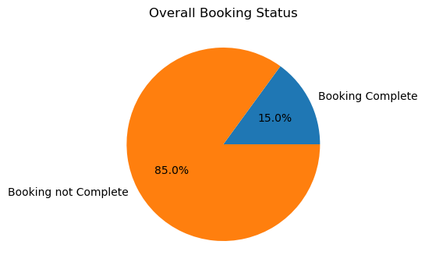
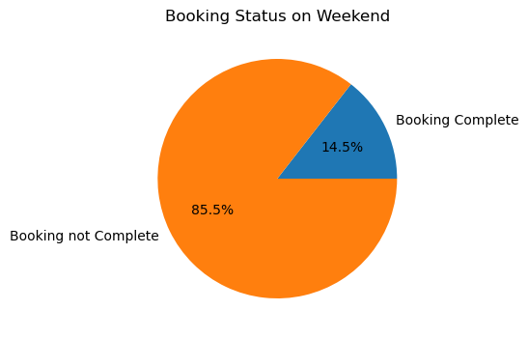
RESULTS
Buying behaviors on weekends
Factors that impact the buying behaviors
Model accuracy
From the below pie charts we can see that there is 0.5% drop in bookings during weekends.
According to the data and our logit model the factors that influence buying behaviors are:
Sales channel
Trip type
Length of stay
Wants extra baggage
Wants preferred seat
Flight duration
Booking origin
We have use logistic regression to predict the buying behavior and we get a accuracy of 85.1%
Accuracy 85.1%

